Slide 1
Chapter 2.5:
Dictionaries and Hash Tables
0
∅
1
025-612-0001
2
981-101-0002
3
∅
4
451-229-0004

Slide 2
Introduction
A computer dictionary is similar to a paper dictionary
  used to look up things.
The user can assign a key to an element
Use this key to later search/remove an element.
The dictionary ADT has methods for
  Removing and searching of elements with keys.
Topics
  Unordered Dictionary ADT
  Log Files
  Hash Tables
  Hash Functions
  Compression Maps
  Collision Resolution methods

Slide 3
The Dictionary ADT (2.5.1)
A dictionary stores items (k,e) - key-element pairs, k is the key and e is the element
Ex : dictionary storing student records
  Key – student id
Some applications – key is the element itself.
Key is an identifier to an element – assigned by the application/user
Types of dictionaries
  Ordered
  Unordered

Slide 4
The Unordered Dictionary ADT (2.5.1)
Allows to store multiple items with the same key.
But some applications – key is unique.

Slide 5
Dictionary ADT (§2.5.1)
Dictionary ADT methods:
  findElement(k): if the dictionary D has an item with key k, returns its element, else, returns the special element NO_SUCH_KEY
  insertItem(k, e): inserts item (k, e) into the dictionary D
  removeElement(k): if the dictionary D has an item with key k, removes it from the dictionary and returns its element, else returns the special element NO_SUCH_KEY
Additional Methods :
  size(), isEmpty()
  keys(), Elements()
Methods with non-unique keys
  findAllElements(k) : returns an iterator of all elements in D with keys equal to k
  removeAllElements(k) : which removes from D, all the items with key equal to k, returns an iterator of their elements

Slide 6
Log File (§2.5.1)
A log file is a dictionary implemented by means of an unsorted sequence
  We store the items of the dictionary in a sequence (based on a doubly-linked lists or a circular array), in arbitrary order
Performance:
  insertItem takes O(1) time since we can insert the new item at the beginning or at the end of the sequence
  findElement and removeElement take O(n) time since in the worst case (the item is not found) we traverse the entire sequence to look for an item with the given key
The log file is effective only for dictionaries of small size or for dictionaries on which insertions are the most common operations, while searches and removals are rarely performed (e.g., historical record of logins to a workstation)

Slide 7
Lookup Table
A lookup table is a dictionary implemented with a sorted sequence
  We store the items of the dictionary in an array-based sequence, sorted by key
  We use an external comparator for the keys
Performance:
  findElement takes O(log n) time, using binary search
  insertItem takes O(n) time since in the worst case we have to shift O(n) items to make room for the new item
  removeElement take O(n) time since in the worst case we have to shift O(n) items to compact the items after the removal
Effective for small dictionaries or for dictionaries where searches are common but inserts and deletes are rare (e.g. credit card authorizations)

Slide 8
Hash Tables (2.5.2)
The keys associated with elements in a dictionary are known as addresses for those elements.
An efficient way of implementing a dictionary is using a hash table.
  Insert, Remove, Find all O(1) expected time
Hash Table has two components :
  A bucket array
    provides storage for elements
  A hash function
    maps keys to buckets

Slide 9
Bucket Array / Simplest Hash Table
A bucket array for a hash table is an array A of size N
Each cell of A is a bucket – contains key-element pairs
Keys are in the range 0 to N-1.
An item (k,e) is inserted into bucket A[k].
Bucket cells associated with keys absent in the dictionary are assumed to hold NO_SUCH_KEY
0 | 1 | 2 | 3 | 4 | 5 | 6
The bucket for items with key = 5

Slide 10
Bucket Array…….
If keys are not unique
  two different elements may map to the same bucket in A.
  A collision has occurred.
  Collision resolving techniques are there, but avoid them.
If keys are unique
  Each bucket has single element
  Searches, insertions and removals in the hash table takes worst case time O(1).
Disadvantage :
  Uses space O(N), not related to n, the size of the dictionary.
  The bucket array needs the keys to be unique in the range [0, N-1], impossible

Slide 11
Bucket Array…..
So, the hash table is defined as a data structure with
A bucket array together with a “good” mapping from the keys to integers [0, N-1].

Slide 12
Hash Functions
Second part of the hash table data structure is a hash function, h
It maps each key k in D to an integer in the range [0, N-1], where N is the capacity of the bucket array.
h[k] is used as an index into the bucket array rather than key k itself.
Item (k,e) is stored in the bucket A[h[k]] instead of A[k].
A hash function is good if it minimizes collisions.

Slide 13
A hash function has to evaluate two actions :
  A hash code – mapping a key to an integer.
  A compression map – maps the hash code to an integer in the range [0, N-1] i.e., the range of indices of a bucket array.
Arbitrary objects
Hash Code
….. …… -2 -1 0 1 2 …..
Compression Map
0 1 2 ………………………N -1

Slide 14
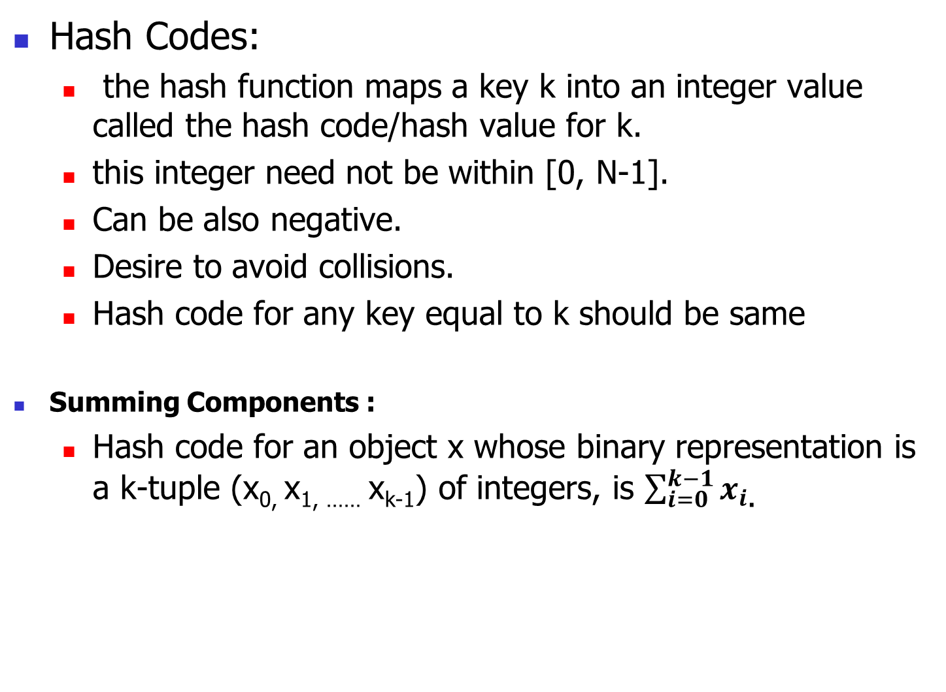
Hash Codes:
  the hash function maps a key k into an integer value called the hash code/hash value for k.
  this integer need not be within [0, N-1].
  Can be also negative.
  Desire to avoid collisions.
  Hash code for any key equal to k should be same
Summing Components :
  Hash code for an object x whose binary representation is a k-tuple (x_{0,} x_{1, ……} x_{k-1}) of integers, is $\sum_{i=0}^{k−1}{x_{i}}$.

Slide 15
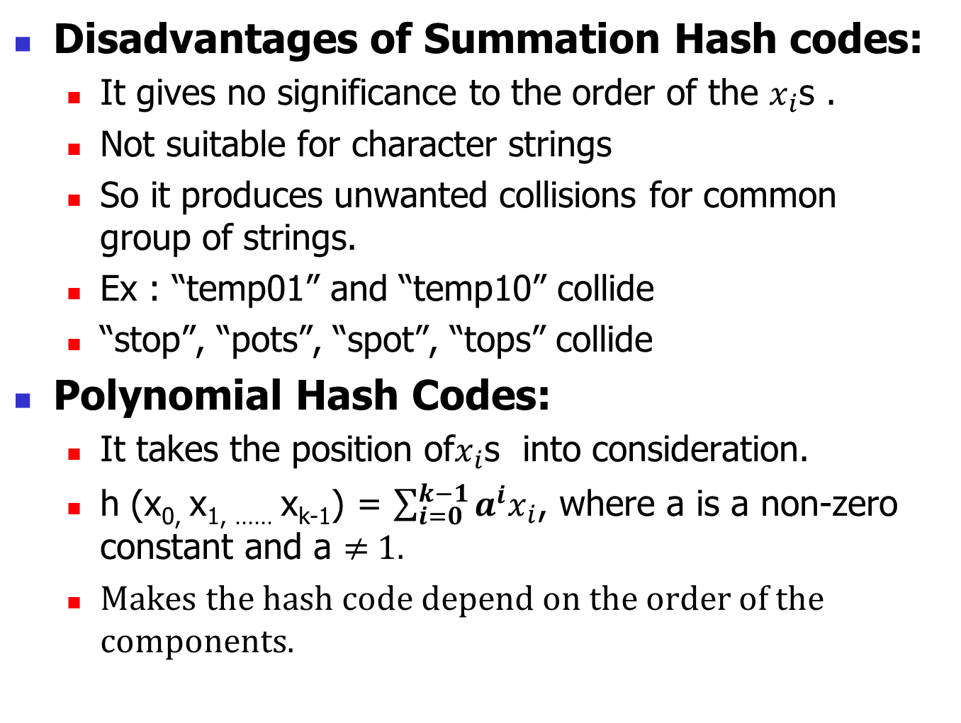
Disadvantages of Summation Hash codes:
  It gives no significance to the order of the $x_{i}$s .
  Not suitable for character strings
  So it produces unwanted collisions for common group of strings.
  Ex : “temp01” and “temp10” collide
  “stop”, “pots”, “spot”, “tops” collide
Polynomial Hash Codes:
  It takes the position of$x_{i}$s into consideration.
  h (x_{0,} x_{1, ……} x_{k-1}) = $\sum_{i=0}^{k−1}{a^{i}x_{i}}$, where a is a non-zero constant and a ≠ 1.
  Makes the hash code depend on the order of the components.

Slide 16
In working with characters strings good choices for k are 33,37, 39 and 41 for characters strings that are English words.

Slide 17
Compression Maps:
The hash code for a key k will be in the range which exceeds the legal indices of the bucket array.
It can be even negative.
So, it cannot be immediately used to index the bucket array.
The integer hash code for a key k, has to be mapped into the range [0, N-1].
This compression step is the second action of a hash function.

Slide 18
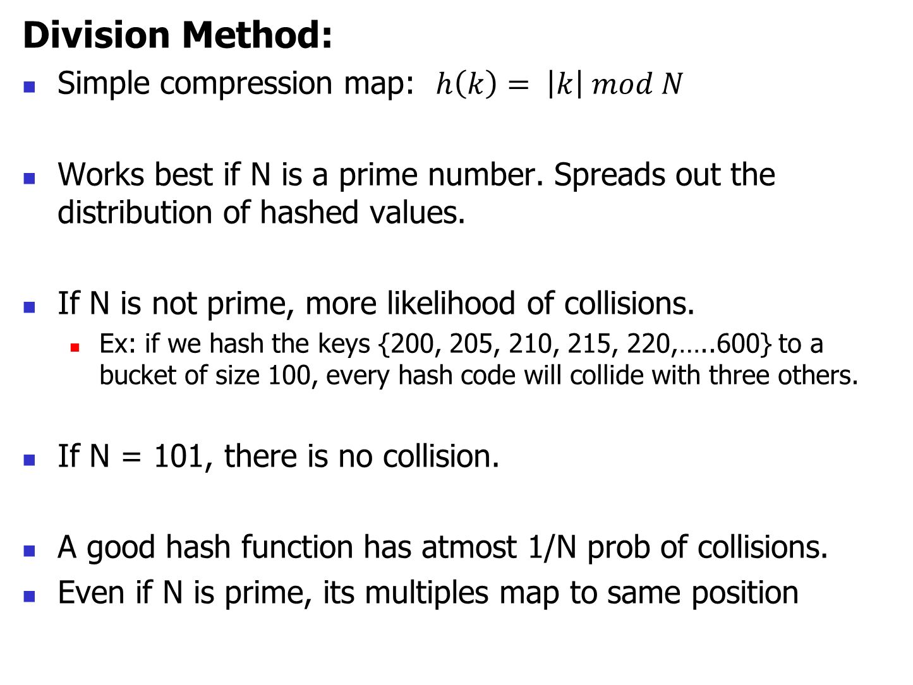
Division Method:
Simple compression map: $h\left(k\right)= \left|k\right| mod N$
Works best if N is a prime number. Spreads out the distribution of hashed values.
If N is not prime, more likelihood of collisions.
  Ex: if we hash the keys {200, 205, 210, 215, 220,…..600} to a bucket of size 100, every hash code will collide with three others.
If N = 101, there is no collision.
A good hash function has atmost 1/N prob of collisions.
Even if N is prime, its multiples map to same position

Slide 19

MAD (multiply, add and divide)method:
The compression function is defined as
$$h\left(k\right)= \left|ak+b\right| mod N$$
where N is a prime number, a and b are randomly chosen such that a mod N ≠ 0.
Eliminates collisions by repeated patterns.

Slide 20
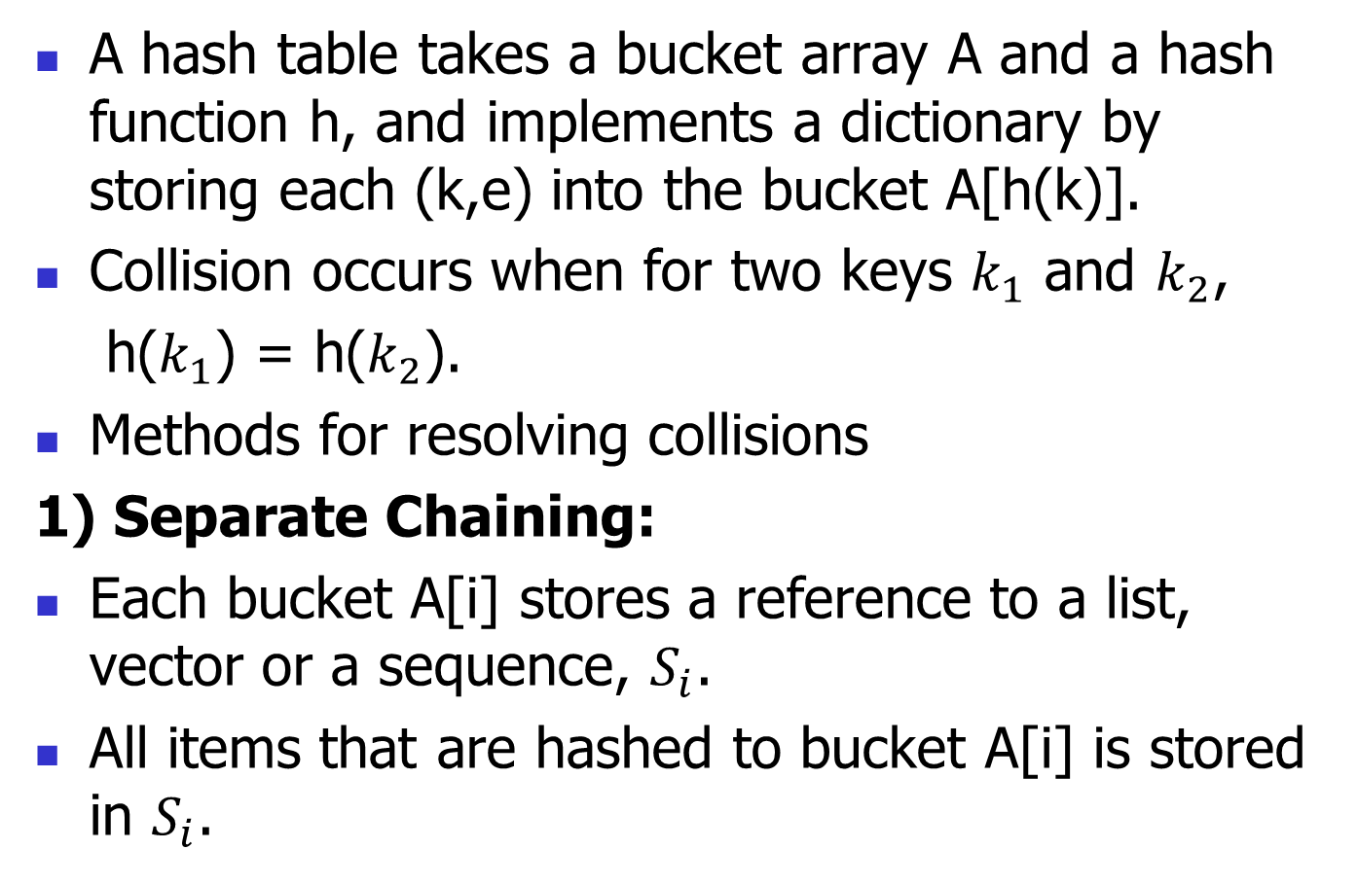
Collision-Handling Schemes
A hash table takes a bucket array A and a hash function h, and implements a dictionary by storing each (k,e) into the bucket A[h(k)].
Collision occurs when for two keys $k_{1}$ and $k_{2}$,
h($k_{1}$) = h($k_{2}$).
Methods for resolving collisions
1) Separate Chaining:
Each bucket A[i] stores a reference to a list, vector or a sequence, $S_{i}$.
All items that are hashed to bucket A[i] is stored in $S_{i}$.

Slide 21

Chaining Example
N = 13, and division compression function,
insert the keys 90, 41, 18, 36,10, 12, 38, 54,
28,25 using separate chaining
Compression map is h(k) = $\left|k\right| mod N$

Slide 22
Collision-Handling Schemes….
findElement(k) :
B ⟵ A[h(k)]
if B is empty then
return NO_SUCH_KEY
else
{search for key k in the
sequence for this
bucket}
return B.findElement(k)
removeElement(k) :
B ⟵ A[h(k)]
if B is empty then
return NO_SUCH_KEY
else
return B.removeElement(k)

Slide 23
Collision-Handling Schemes….
insertItem(k,e):
if A[h(k)] is empty then
{Create a new initially empty, sequence-
based dictionary B}
A[h(k)] ⟵ B
else
B ⟵ A[h(k)]
B.insertItem(k,e)

Slide 24
Separate Chaining
Every A[h(k)] stores a miniature sequence-based dictionary.
Insertion – puts the new item at the end of the sequence A[h(k)]
Find – searches the sequence till the end/finds the element.
Remove – additionally remove an item once it is found.

Slide 25
Load Factors and Rehashing
The performance of collision resolution methods depends on the load factor, expected size of each bucket i.e, n/N
  Where n is the no. of keys and
  N is the no. of hash addresses.
The efficiency of a hash function with a collision resolution procedure, is measured by the no. of average no. of comparisons (probes) needed to locate a key k.
This depends on the load factor.

Slide 26
Load Factors and Rehashing
To keep the load factor constant, additional work is done each time an element is added.
  Need to increase the size of the bucket array
  Change the compression map.
  Insert all existing hash table elements into the new bucket array using the new compression map.
Rehashing – size increase and hash table rebuild
Good choice – rehash into an array double the size of the original array.

Slide 27
Open Addressing
Separate chaining needs an auxiliary data structure – vector, lists – to maintain the colliding values.
This method stores each item directly in a bucket, atmost one item per bucket.
Uses no auxiliary structures.
Needs efficient collision resolving methods.

Slide 28
1. Linear Probing :
A simple open-address collision handling strategy.
to insert an item (k,e)
  get the hash code i = h(k),
  If bucket A[i] is free insert item into A[i]. Otherwise, try next A[(i + 1) mod N]. If this is also occupied try next A[(i + 2) mod N] and so on.
  Find an empty bucket in A that can accept (k,e).
Removal is complicated.

Slide 29
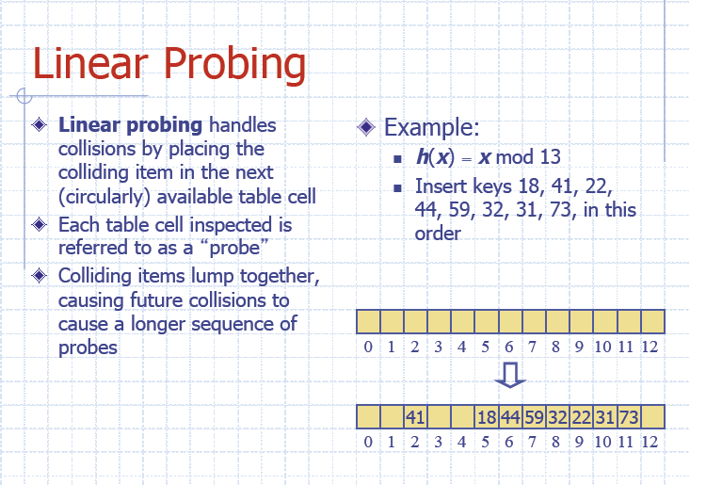

Slide 30
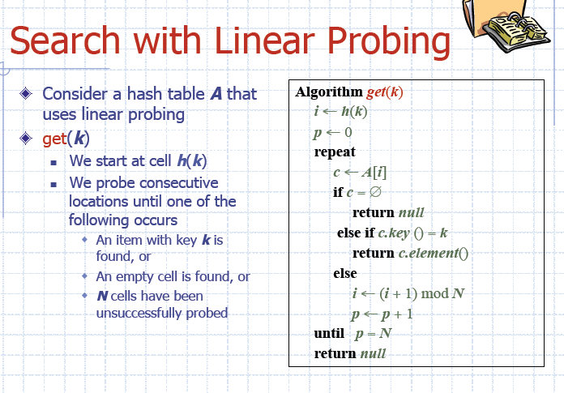

Slide 31
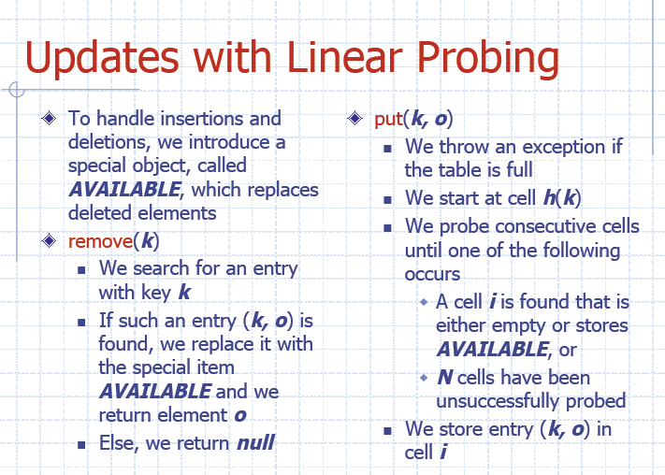

Slide 32
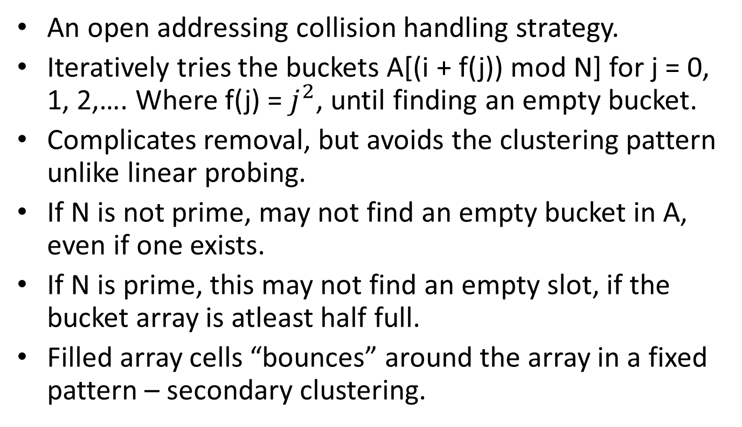
2. Quadratic Probing
An open addressing collision handling strategy.
Iteratively tries the buckets A[(i + f(j)) mod N] for j = 0, 1, 2,…. Where f(j) = $j^{2}$, until finding an empty bucket.
Complicates removal, but avoids the clustering pattern unlike linear probing.
If N is not prime, may not find an empty bucket in A, even if one exists.
If N is prime, this may not find an empty slot, if the bucket array is atleast half full.
Filled array cells “bounces” around the array in a fixed pattern – secondary clustering.

Slide 33
Ex : h(k,i) = (h’(k) + c₁i + c₂i²) mod m for i=0,1,2,3…….m-1
where m is the size of the hash table. C₁ and c₂ are constants.
h’(k) = k mod m is the primary hash function.

Slide 34
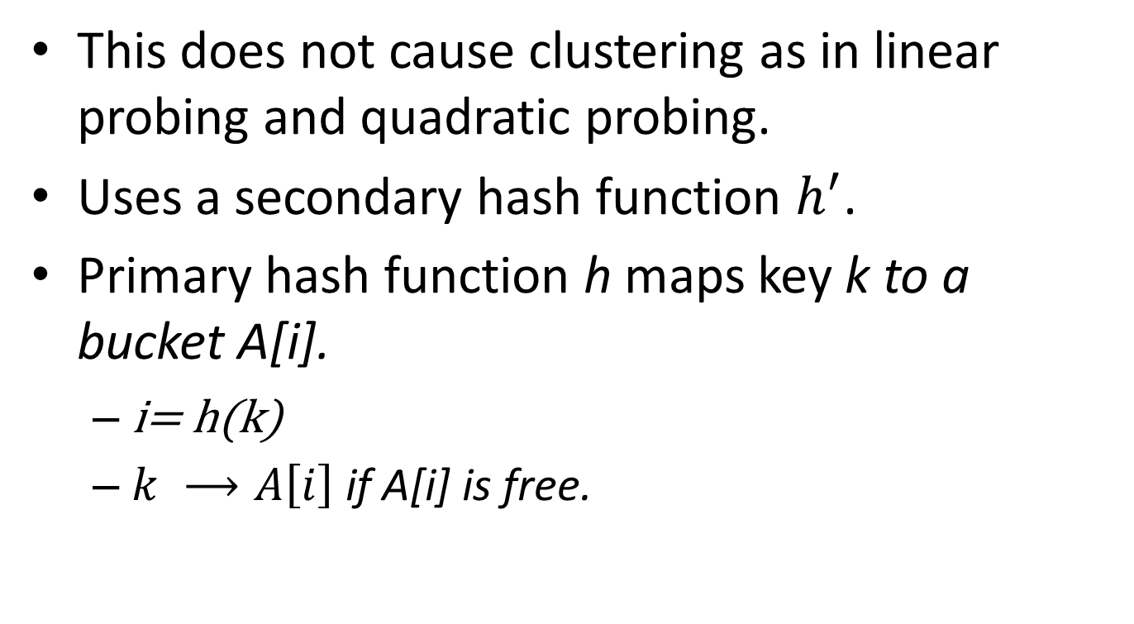
3. Double Hashing
This does not cause clustering as in linear probing and quadratic probing.
Uses a secondary hash function $h^{′}$.
Primary hash function h maps key k to a bucket A[i].
  i= h(k)
  $k ⟶A\left[i\right]$if A[i] is free.

Slide 35
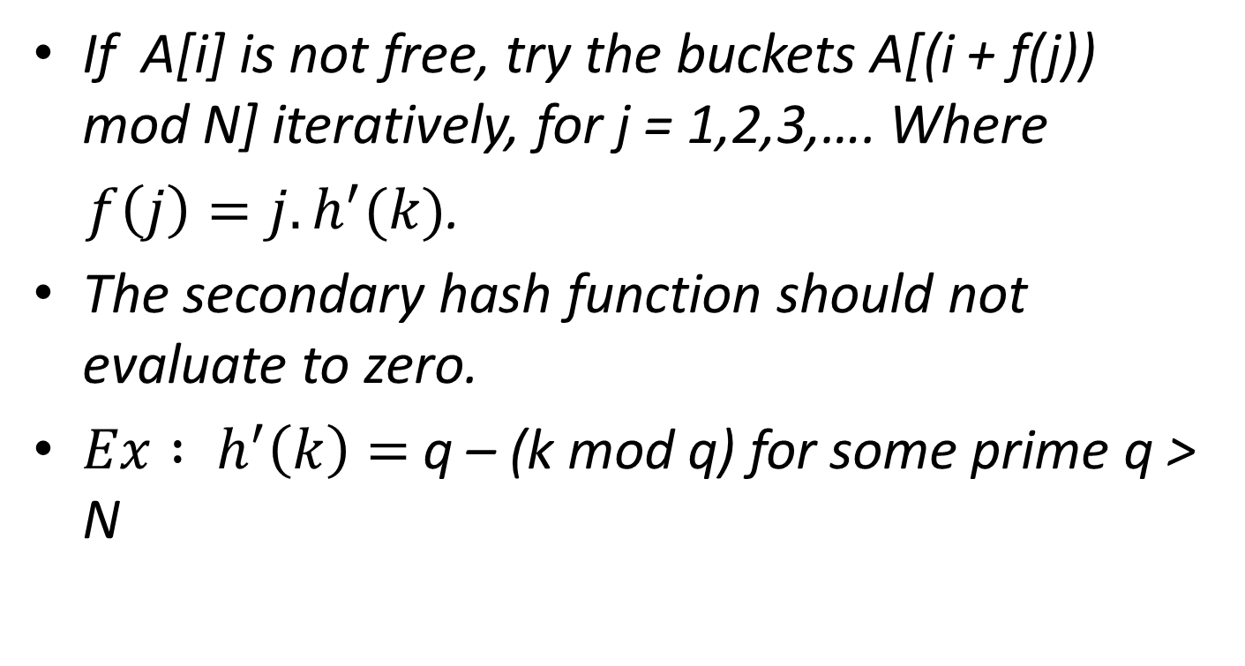
If A[i] is not free, try the buckets A[(i + f(j)) mod N] iteratively, for j = 1,2,3,…. Where
$f\left(j\right)=j.h^{′}(k)$.
The secondary hash function should not evaluate to zero.
${Ex : h}^{′}\left(k\right)=$q – (k mod q) for some prime q > N

Slide 36
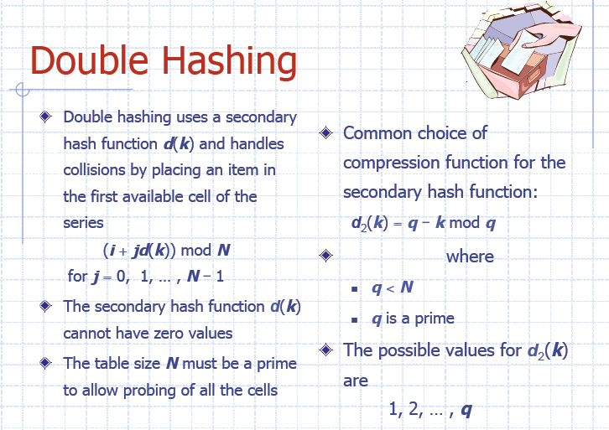

Slide 37
Example of Double Hashing
Consider a hash table storing integer keys that handles collision with double hashing
  N = 13
  h(k) = k mod 13
  d(k) = 7 − k mod 7
Insert keys 18, 41, 22, 44, 59, 32, 31, 73, in this order
0
1
2
3
4
5
6
7
8
9
10
11
12
31
41
18
32
59
73
22
44
0
1
2
3
4
5
6
7
8
9
10
11
12

Slide 38
Dynamic Hash Tables
Suppose you are making a symbol table for a compiler. How big should you make the hash table?
If you don’t know in advance how big a table to make, what to do?
Could grow the table when it “fills” (e.g. 50% full)
Make a new table of twice the size.
Make a new hash function
Re-hash all of the items in the new table
Dispose of the old table

Slide 39
Table Growing Analysis
Worst case insertion: Θ(n), to re-hash all items
Can we make any better statements?
Average case?
  O(1), since insertions n through 2n cost O(n) (on average) for insertions and O(2n) (on average) for rehashing → O(n) total (with 3x the constant)
Amortized analysis?
  The result above is actually an amortized result for the rehashing.
  Any sequence of j insertions into an empty table has O(j) average cost for insertions and O(2j) for rehashing.
  Or, think of it as billing 3 time units for each insertion, storing 2 in the bank. Withdraw them later for rehashing.

Slide 40
Separate Chaining vs.
Double Hashing
Assume the same amount of space for keys, links (use pointers for long or variable-length keys)
Separate chaining:
  1M buckets, 4M keys
  4M links in nodes
  9M words total; avg search time 2
Double hashing in same space:
  4M items, 9M buckets in table
  average search time: 1/(1-4/9) = 1.8: 10% faster
Double hashing in same time
  4M items, average search time 2
  space needed: 8M words (1/(1-4/8) = 2) (11% less space)

Slide 41
Deletion
How to implement delete() with separate chaining?
  Simply unlink unwanted item
  Runtime?
  Same as search()
How to implement delete() with linear probing?
  Can’t just erase it. (Why not?)
  Re-hash entire cluster
  Or mark as deleted?
How to delete() with double hashing?
  Re-hashing cluster doesn’t work – which “cluster”?
  Mark as deleted
  Every so often re-hash entire table to prune “dead-wood”

Slide 42
Comparisons
Separate chaining advantages:
  Idiot-proof (degrades gracefully)
  No large chunks of memory needed (but is this better?)
Why use hashing?
  Fastest dictionary implementation
  Constant time search and insert, on average
  Easy to implement; built into many environments
Why not use hashing?
  No performance guarantees
  Uses extra space
  Doesn’t support pred, succ, sort, etc. – no notion of order
Where did perl “hashes” get their name?

Slide 43
Hash Tables in C#
System.Collections: basic data structures
Hashtable
ArrayList
(See handout)

Slide 44
Hashing Summary
Separate chaining: easiest to deploy
Linear probing: fastest (but takes more memory)
Double hashing: least memory (but takes more time to compute the second hash function)
Dynamic (grow): handles any number of inserts at < 3x time
Curious use of hashing: early unix spell checker (back in the days of the 3M machines…)
Construction Search Miss
Chain Probe Dbl Grow Chain Probe Dbl Grow
5k 1 4 4 3 1 0 1 0
50k 18 11 12 22 15 8 8 8
100k 35 21 23 47 45 23 21 15
190k 79 106 59 155 144 2194 261 30
200k 84 159 156 33

Slide 45
GUI Programming in C#
Microsoft has provided a number of different GUI programming environments over the years:
  MFC: Microsoft Foundation Classes
  Windows Forms
  WPF: Windows Presentation Foundation
    XML file defines user interface
  Windows 8: HTML/CSS/JavaScript?
Notes:
MFC: old C++-based library fro GUI programming.
Windows Forms:.Net GUI api. Replaces MFC. (Not the most recent, though.) Like Java’s AWT.
Obsolete, but still used.
WPF previously known as Avalon. Released as part of .Net 3.0. Uses DirectX.
Uses XML-oriented object model, XAML, to define a user interface and link various UI elements.
Runtime libraries are included with all recent versions of windows.
Sliverlight is mostly a subset of WPF for embedded Web controls.

